Slide 1

Data structure week 0ne
Contact Details:
Email: sobia.iftikhar@nu.edu.pk
GCR:

Slide 2
Distribution of Assessment
Midterm Exam 1: 15 (1 Hour written exam)
Midterm Exam 2: 15 (1 Hour written exam)
Project: 10
Quizzes: 10 (Four Surprise quizzes – best three counted)
Final: 50 (3 Hours Written Exam)

Slide 3
Books
Data Structures Using C++ by VARSHA H. PATIL Oxford University Press
Data Structures and Algorithm Analysis by Clifford A. Shaffer
Open Data Structures in C++
Open Data Structures in Java

Slide 4
What this course will cover ?
Introduction to Algorithm Analysis
Lists, Stacks, Queues
Trees, Hashing, Dictionaries
Heaps, Priority Queues
Sorting
Graph Algorithms

Slide 5
Outline
ADT,
Java Language Specification
Arrays
Garbage Collector
Recursion

Slide 6
Java language specification
Classes and Objects
Array
Array List
Garbage Collector
Constructor with shallow copy and Deep Copy
Recursion vs Iteration

Slide 7
Class One

Slide 8
Classes and Object
class Lamp {
// stores the value for light
// true if light is on
// false if light is off
boolean isOn;
// method to turn on the light
void turnOn() {
isOn = true;
System.out.println("Light on? " + isOn);
}
// method to turnoff the light
void turnOff() {
isOn = false;
System.out.println("Light on? " + isOn);
}
}
class Main {
public static void main(String[] args) {
// create objects led and halogen
Lamp led = new Lamp();
Lamp halogen = new Lamp();
// turn on the light by
// calling method turnOn()
led.turnOn();
// turn off the light by
// calling method turnOff()
halogen.turnOff();
}
}

Slide 9
Fundamental types
●
Java provides ten fundamental types:
integers: byte, short, int and long floating point: float and double. characters: char.
boolean void String
–
–
–
–
–
–
10

Slide 10
Constants
●
Constants are declared with the word final in front. The specification of the initial value is compulsory:
final | double pi = 3.1415; | // | constant PI
final | int maxSize = 100; | // | integer constant
final | char lastLetter = ’z’; | // | last lowercase letter
final | String word = "Hello"; | // | a constant string
14

Slide 11
String operators
class Strings2 {
public static void main(String[] args) {
String s1 = "Hello"; String s2 = "Hello";
System.out.println(s1.equals(s2)); System.out.println(s1.equals("Hi"));
}
}
$ java Strings2 true
false
29

Slide 12
Default constructors
●
Java provides a default constructor for the classes.
b = new Book();
●
This default constructor is only available when no constructors are defined in the class.
51

Slide 13
Multiple constructors
●
It is possible to define more than one constructor for a single class, only if they have different number of arguments or different types for the arguments.
a = | new | Book("Thinking in Java","Bruce | Eckel",1129);
b = | new | Book("Thinking in Java","Bruce | Eckel",1129,"0-13-027363");
title author
"Thinking in Java"
title author
"Thinking in Java"
"Bruce Eckel"
"Bruce Eckel"
a
numberOfPages
1129
b
numberOfPages
1129
ISBN
"unknown"
ISBN
"0-13-027363-5"
52

Slide 14
Multiple constructors
class Book { String title; String author;
int numberOfPages; String ISBN;
Book(String tit,String aut,int num) { title = tit; author = aut; numberOfPages = num;
ISBN = "unknown";
}
Book(String tit,String aut,int num,String isbn) { title = tit; author = aut;
numberOfPages = num;
ISBN = isbn;
}
}
53

Slide 15
Arrays
Array is the simplest data structure where each data element can be randomly accessed by using its index number.
Arrays in Java, are data structures, which are defined as the collection of similar types of data items stored at contiguous memory locations.
One Dimensional Array
Multidimensional Array

Slide 16
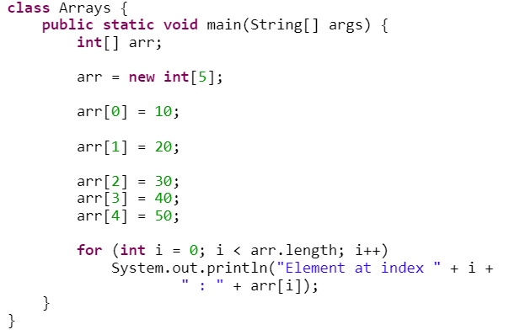
One Dimensional Array
Insert 5 integer elements from 10 to 50 and display with index value.

Slide 17
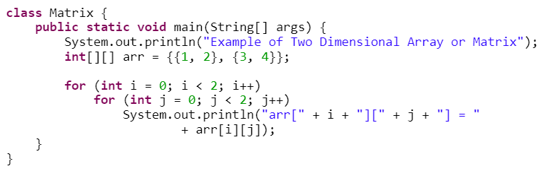
2D ARRAY
2D array can be defined as an array of arrays also known as Matrix. The 2D array is organised as the collection of rows and columns.
Element in 2D array are also stored in contiguous memory locations but require 2 indices for navigation, one row index and one column index

Slide 18
Java language support for arrays
Basic support
operation | typical code
Declare an array reference | double[] a;
Create an array of a given length | a = new double[1000];
Refer to an array entry by index | a[i] = b[j] + c[k];
Refer to the length of an array | a.length;
18

Slide 19
Garbage Collector
Java garbage collection is the process by which Java programs perform automatic memory management.
When Java programs run on the JVM, objects are created on the heap, which is a portion of memory dedicated to the program. Eventually, some objects will no longer be needed. The garbage collector finds these unused objects and deletes them to free up memory.
We can request JVM to run Garbage Collector. Using System.gc() method: System class contain static method gc() for requesting JVM to run.
Finalization: Just before destroying an object, Garbage Collector calls finalize() method on the object to perform cleanup activities.

Slide 20
Garbage Collection
When does java perform garbage collection?.
When one reference is copied to another reference:
BeginnersBook obj1 = new BeginnersBook();
BeginnersBook obj2 = new BeginnersBook();
obj2 = obj1;
When the object is no longer reachable:
BeginnersBook obj = new BeginnersBook();
obj = null;

Slide 21
Deep and shallow copy
class ABC
{
int x = 30;
}
public class DeepCopyExample
{
public static void main(String argvs[])
{
ABC obj1 = new ABC();
ABC obj2 = new ABC();
obj2.x = 6;
System.out.println("The value of x is: " + obj1.x);
}
}
class ABC
{
int x = 30;
}
public class ShallowCopyExample
{
public static void main(String argvs[])
{
ABC obj1 = new ABC();
ABC obj2 = obj1;
obj2.x = 6;
System.out.println("The value of x is: " + obj1.x);
}
}

Slide 22
Exceptions
●
The usual behavior on runtime errors is to abort the execution:
class TestExceptions1 {
public static void main(String[] args) {
String s = "Hello"; System.out.print(s.charAt(10));
}
}
$ java TestExceptions1 Exception in thread "main"
java.lang.StringIndexOutOfBoundsException:
String index out of range: 10
at java.lang.String.charAt(String.java:499)
at TestExceptions1.main(TestExceptions1.java:11)

Slide 23
Exceptions
●
The exception can be trapped:
class TestExceptions2 {
public static void main(String[] args) {
String s = "Hello"; try {
System.out.print(s.charAt(10));
} catch (Exception e) { System.out.println("No such position");
}
}
$ java TestExceptions2 No such position

Slide 24
Exceptions
●
It is possible to specify interest on a particular exception:
class TestExceptions3 {
public static void main(String[] args) {
String s = "Hello"; try {
System.out.print(s.charAt(10));
} catch (StringIndexOutOfBoundsException e) { System.out.println("No such position");
}
}
$ java TestExceptions3 No such position

Slide 25
Exceptions
●
It is possible to send messages to an exception object:
class TestExceptions4 {
public static void main(String[] args) {
String s = "Hello"; try {
System.out.print(s.charAt(10));
} catch (StringIndexOutOfBoundsException e) { System.out.println("No such position"); System.out.println(e.toString());
}
}
$ java TestExceptions4 No such position
java.lang.StringIndexOutOfBoundsException:
String index out of range: 10

Slide 26
Class Two

Slide 27
Writing and Reading the File
class Main {
public static void main(String[] args) {
// create a file object for the current location
File file = new File("newFile.txt");
try {
// trying to create a file based on the object
boolean value = file.createNewFile();
if (value) {
System.out.println("The new file is created.");
}
else {
System.out.println("The file already exists.");
}
}
catch(Exception e) {
e.getStackTrace();
}
}
}
Create a Java File Object :
File file = new File(String pathName);
Operation | Method | Package
To create file | createNewFile() | java.io.File
To read file | read() | java.io.FileReader
To write file | write() | java.io.FileWriter
To delete file | delete() | java.io.File

Slide 28
Writing and Reading the File
// importing the FileReader class
import java.io.FileReader;
class Main {
public static void main(String[] args) {
char[] array = new char[100];
try {
// Creates a reader using the FileReader
FileReader input = new FileReader("input.txt");
// Reads characters
input.read(array);
System.out.println("Data in the file:");
System.out.println(array);
// Closes the reader
input.close();
}
catch(Exception e) {
e.getStackTrace();
}
}
}
Read a file using FileReader:
FileReader input = new FileReader("input.txt");

Slide 29
Writing and Reading the File
import java.io.FileWriter;
class Main {
public static void main(String args[]) {
String data = "This is the data in the output file";
try {
// Creates a Writer using FileWriter
FileWriter output = new FileWriter("output.txt");
// Writes string to the file
output.write(data);
System.out.println("Data is written to the file.");
// Closes the writer
output.close();
}
catch (Exception e) {
e.getStackTrace();
}
}
}
Write to file using FileWriter:
FileWriter output = new FileWriter("output.txt");
Delete File:
File Dfile = New File(File Name);
Boolean var = Dfile.delete();

Slide 30
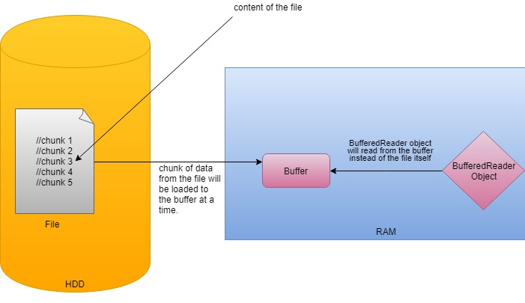
Writing and Reading the File
class Main {
public static void main(String[] args) {
char[] array = new char[100];
try {
// Creates a FileReader
FileReader file = new FileReader("input.txt");
// Creates a BufferedReader
BufferedReader input = new BufferedReader(file);
// Reads characters
input.read(array);
System.out.println("Data in the file: ");
System.out.println(array);
input.close();
}
catch(Exception e) {
e.getStackTrace();
}
}
}
Buffered Class: Buffer Reader and Buffer Writer
During the read operation in BufferedReader, a chunk of characters is read from the disk and stored in the internal buffer. And from the internal buffer characters are read individually.
Hence, the number of communication to the disk is reduced. This is why reading characters is faster using BufferedReader.

Slide 31
Writing and Reading the File
import java.io.FileWriter;
import java.io.BufferedWriter;
public class Main {
public static void main(String args[]) {
String data = "This is the data in the output file";
try {
// Creates a FileWriter
FileWriter file = new FileWriter("output.txt");
// Creates a BufferedWriter
BufferedWriter output = new BufferedWriter(file);
// Writes the string to the file
output.write(data);
output.close();
}
catch (Exception e) {
e.getStackTrace();
}
}
}
Buffered Class:
Buffer Writer
flush() Method

Slide 32
Array List
In Java, we use the ArrayList class to implement the functionality of resizable-arrays.
In Java, we need to declare the size of an array before we can use it. Once the size of an array is declared, it's hard to change it.
To handle this issue, we can use the ArrayList class. It allows us to create resizable arrays.
Unlike arrays, arraylists can automatically adjust their capacity when we add or remove elements from them. Hence, arraylists are also known as dynamic arrays.

Slide 33
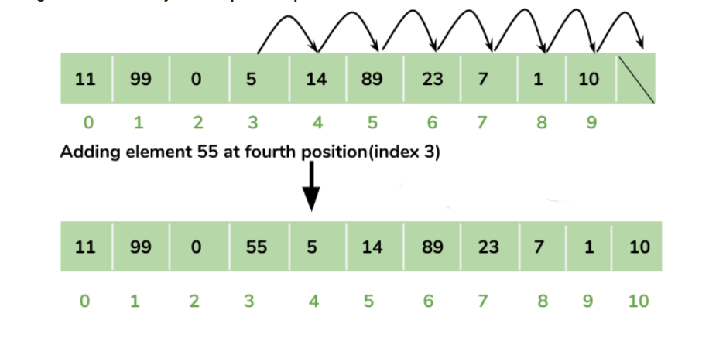
ArrayList can dynamically grow and shrink after addition and removal of elements

Slide 34
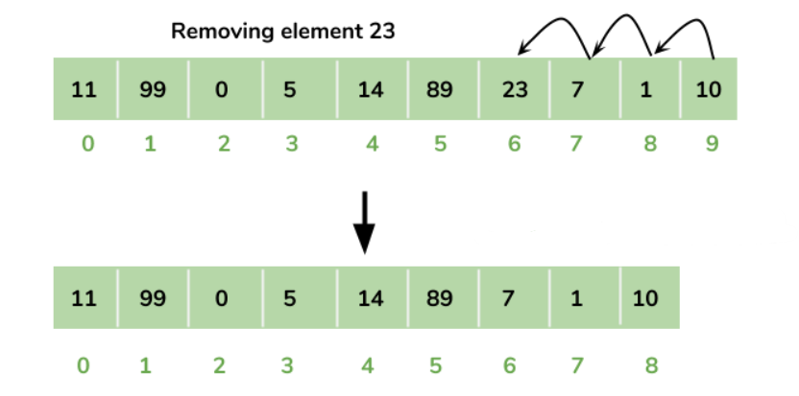
Removing Element from ArrayList:

Slide 35
Creating Array List
Before using ArrayList, we need to import the java.util.ArrayList package first. Here is how we can create arraylists in Java:
ArrayList<Type> arrayList= new ArrayList<>();
In the above program, we have used Integer not int.

Slide 36
Basic Operation in Array List
Add elements
Access elements
Change elements
Remove elements

Slide 37
Example
Create Arraylist that will contain 5 names of countries starting with latter A and then display in single row, after that update your list and add one more country name on the index of 2 then display again.
Lets suppose you are going to start your next semester for that you have to choose any 4 subjects out of 6 [DS, PF,OS,SDA,SRE,COAL]. Initially you selected first four courses. But after that you want to change first course with sixth course. Write a program that will implement above situation.
You are allowed to select only four course but mistakenly you selected 5 five course now system will generate error to remove any on course from you selection.

Slide 38
Class three

Slide 39
Recursion and its Types
Recursion is a concepts in which function call it self.
Example:
Public class RescurionExample{
Public static void main(string[] arg){
SayHi();
}
Private void SayHi(){
System.out.println(“hi”);
SayHi();
}
}
Three steps:
Find Base Case
Find the relation between problem and sub problem
Generalize the case

Slide 40
Recursion
The problem is just keep calling over and over.
We need some exit condition strategy called base case.
Example:
Public class RescurionExample{
Public static void main(string[] arg){
SayHi(3);
}
Private void SayHi(int count ){
System.out.println(“hi”);
If(count<=1) return;
SayHI(count-1);
}
}

Slide 41
Example
public class Main
{
//method to calculate fibonacci series
static int fibonacci(int n) {
if (n <= 1) {
return n;
}
return fibonacci(n-1) + fibonacci(n-2);
}
public static void main(String[] args) {
int number = 10;
//print first 10 numbers of fibonacci series
System.out.println ("Fibonacci Series: First 10 numbers:");
for (int i = 1; i <= number; i++)
{
System.out.print(fibonacci(i) + " ");
}
}
}
The program to implement the Fibonacci series is given below:

Slide 42
Find the Minimum value from Array
import java.util.*;
class Main
{
static int getMin(int numArray[], int i, int n)
{
//return first element if only one element or minimum of the array elements
return (n == 1) ? numArray[i] :
Math.min(numArray[i], getMin(numArray,i + 1 , n - 1));
}
public static void main(String[] args)
{
int numArray[] = { 7,32,64,2,10,23 };
System.out.println("Given Array : " + Arrays.toString(numArray));
int n = numArray.length;
System.out.print("Minimum element of array: " + getMin(numArray, 0, n) + "\n");
}
}

Slide 43
Types of Recursion
Different types of Recursion
Direct
Indirect
Tail
Non Tail

Slide 44
Tail & non-Tail Recursion
Tail Recursion
methodName ( T parameters…){
{
if (base_condition == true)
{
return result;
}
return methodName (T parameters …) //tail recursion
}
Head Recursion
methodName (T parameters…){
if (some_condition == true)
{
return methodName (T parameters…);
}
return result;
}

Slide 45
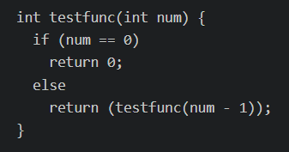
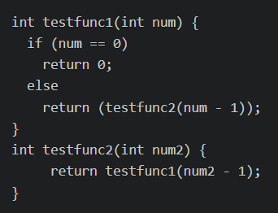
Direct and Indirect Recursion
Direct Recursion
Indirect Recursion

Slide 46
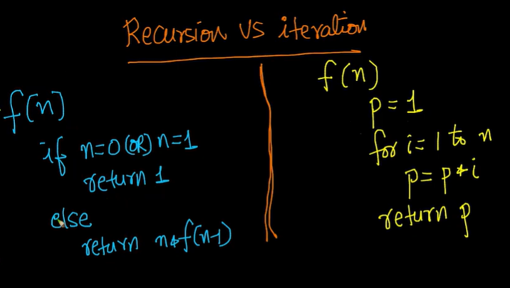
Iteration vs recursion

Slide 47
Thankyou

